Slide 1
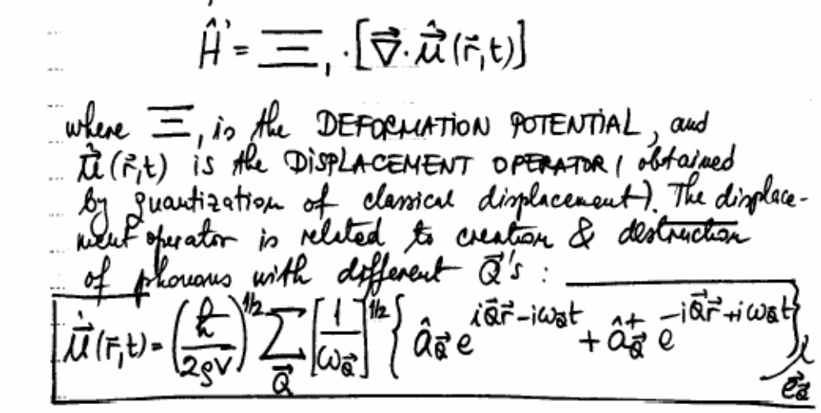

Acoustic Phonons
The Hamiltonian

Slide 2
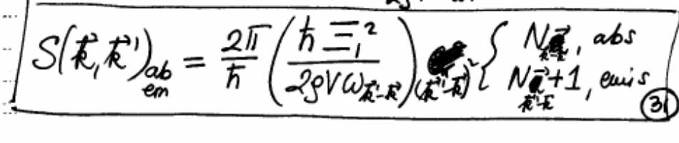
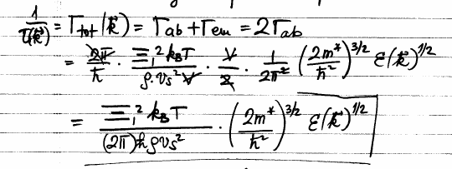
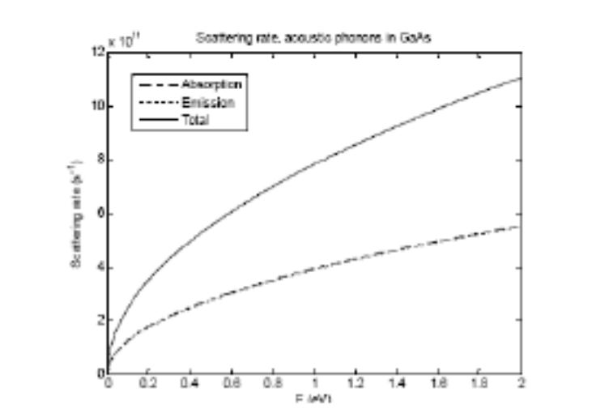
Acoustic Phonons
Transition rate
Total scattering rate (a.k.a. total relaxation rate)

Slide 3
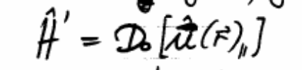
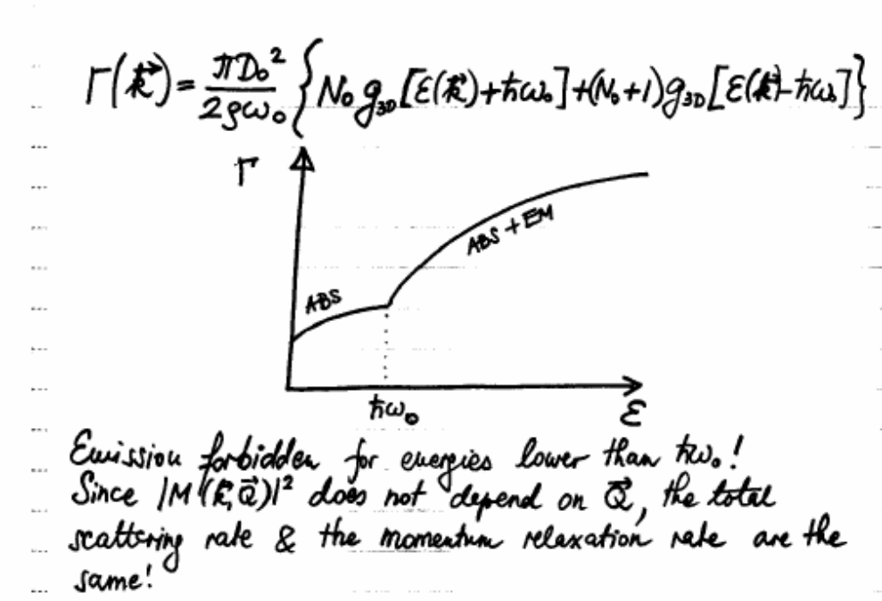
Intravalley Optical Phonon Scattering
The Hamiltonian
Total scattering rate (a.k.a. total relaxation rate)
Forbidden in Si (as minima along <100>) and GaAs (min at Γ point)

Slide 4
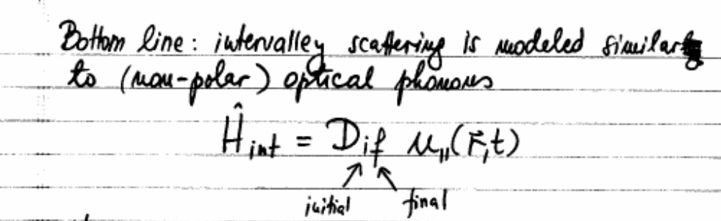
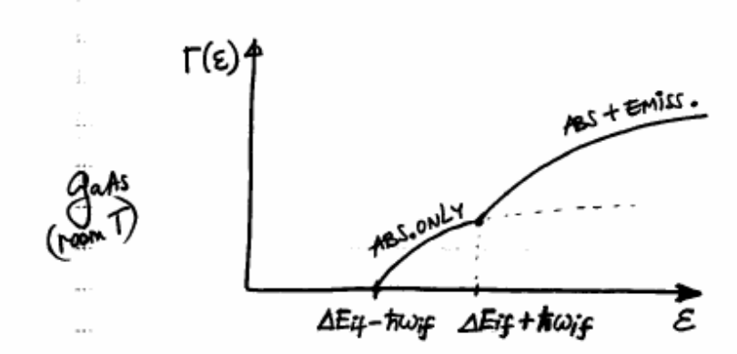
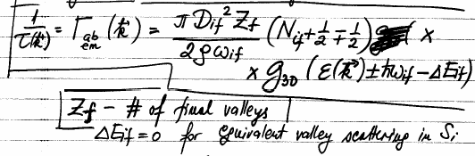
Intervalley Scattering
The Hamiltonian
How? Via long wavelength phonons, either acoustic or optical
For Si, equivalent scattering; difference between f and g processes
For GaAs, non-equivalent scattering Γ→L and Γ→X important if carriers
have enough energy

Slide 5
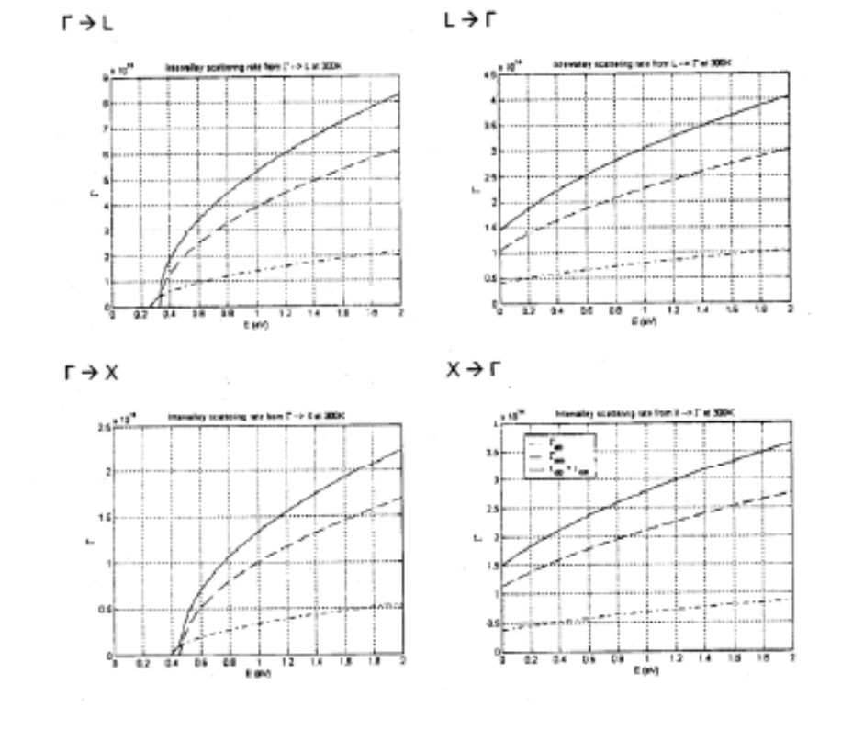
Intervalley Scattering – Cont’d

Slide 6

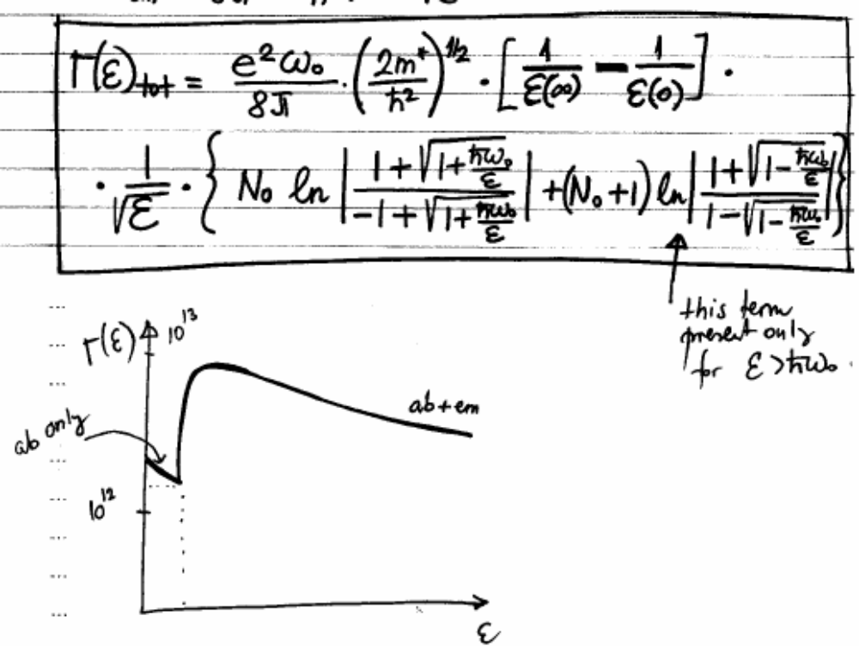
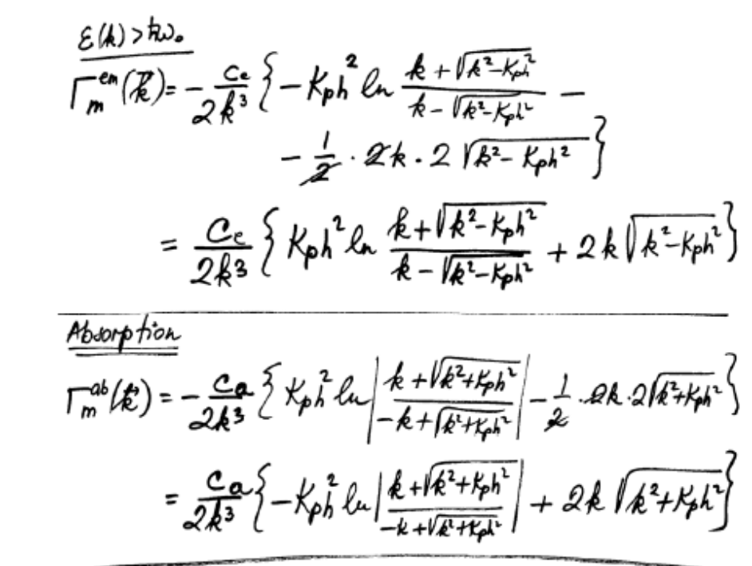
Polar-optical-phonon (POP) scattering
The Hamiltonian
How? In polar semiconductors, lattice vibrations lead to microscopic dipole moments, from which electrons scatter
This scattering mechanism is strongly inelastic (high energy optical phonons) and strongly anisotropic (due to Coulomb nature of the scattering)

Slide 7
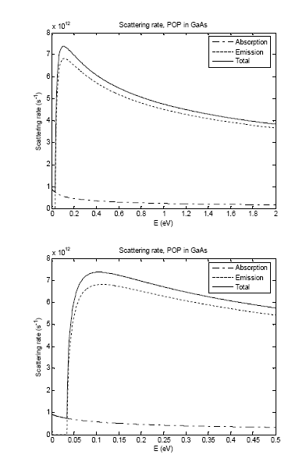
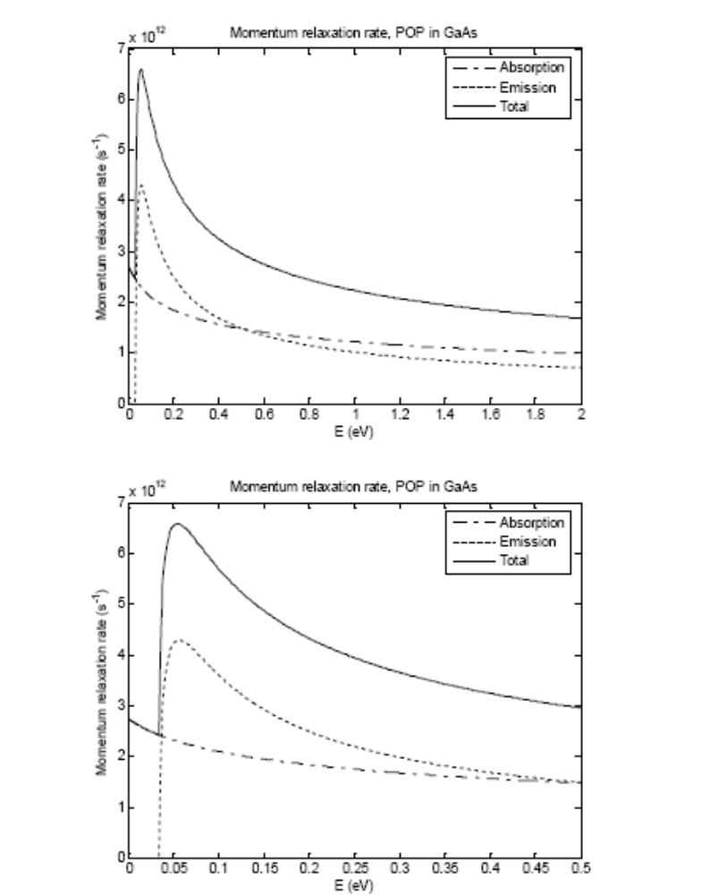
POP scattering – cont’d
Anisotropy: Γ_{m}<Γ

Slide 8
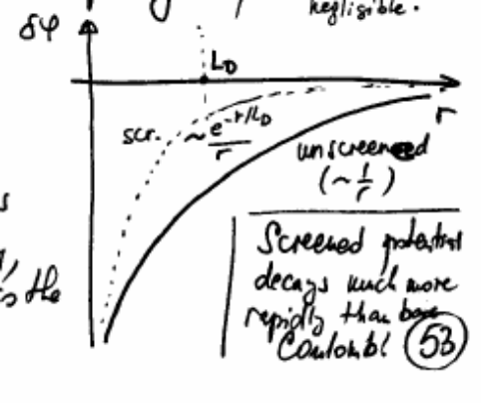

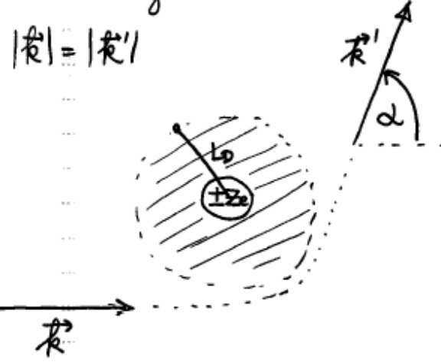
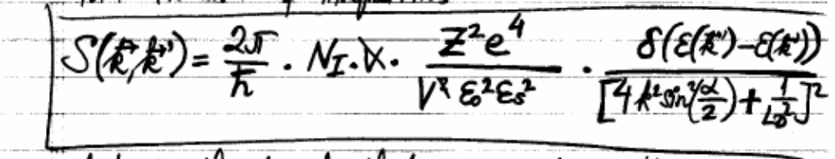
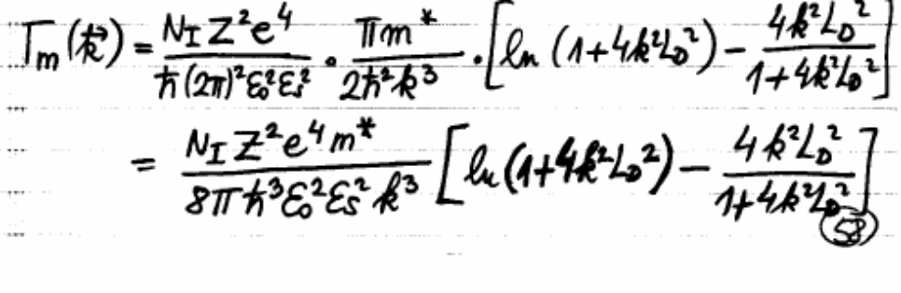
Ionized impurity scattering
The Hamiltonian
Scattering is elastic (no particles emitted or absorbed) but strongly anisotropic (due to Coulomb nature)
Transition rate

Slide 9
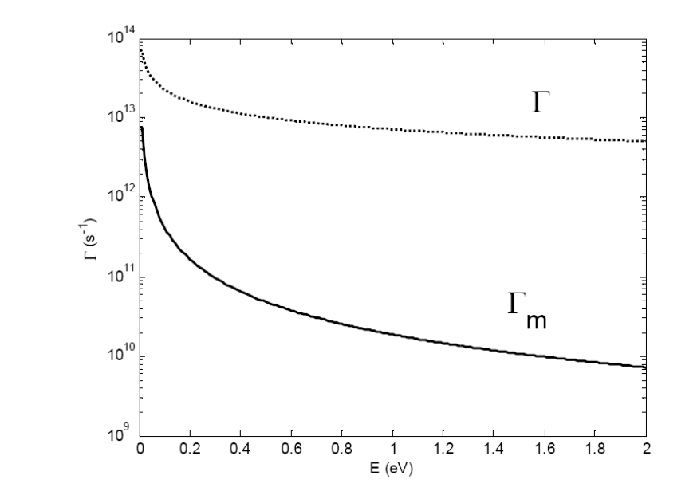
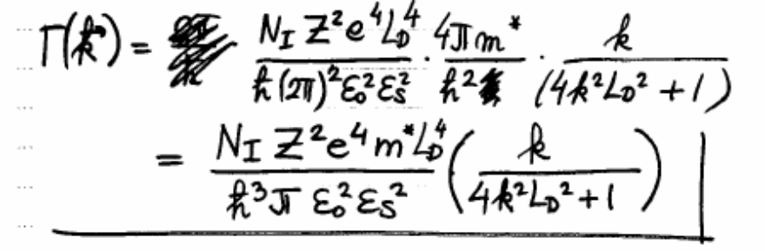
Ionized impurity scattering – cont’d
Total scattering rate
Momentum relaxation rate
Anisotropy viewed through
Γ_{m}<Γ

